Slide 1


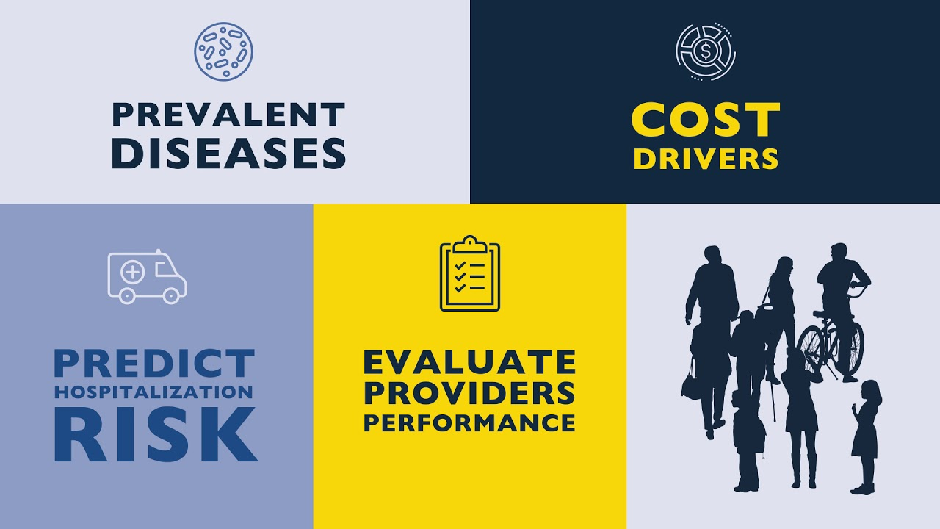
Using Health Analytics in Healthcare Setting
Leading Through Health Analytics 🩺
Relevant References:
Lois J. Gould, MS, PMP, et al. (2015) September, Volume 41 Number 9. Clinical Communities at Johns Hopkins Medicine: An Emerging Approach to Quality Improvement.
https://www.researchgate.net/profile/Maureen_Gilmore/publication/281171939_Clinical_Communities_at_Johns_Hopkins_Medicine_An_Emerging_Approach_to_Quality_Improvement/links/59e11d80458515393d534845/Clinical-Communities-at-Johns-Hopkins-Medicine-An-Emerging-Approach-to-Quality-Improvement.pdf
Amy M. Sitapati, MD, et al. (2012). Building a Patient-Centered Medical Home https://muse.jhu.edu/article/482131
Sezin A. Palmer, Alan D. Ravitz, and Robert S. Armiger. (2021). Johns Hopkins APL Technical Digest, Volume 35, Number 4. Partnering with Johns Hopkins Medicine to Revolutionize Health. https://secwww.jhuapl.edu/techdigest/Content/techdigest/pdf/V35-N04/35-04-Palmer.pdf

Slide 2
Effective use of health analytics to achieve competitive advantages
Predictive Maintenance of Medical Equipment - Using big data and health analytics, Through health analytics, Johns Hopkins Medicine can track the performance and usage of critical medical equipment. This is crucial in maintaining MRI machines, CT scanners, and surgical robots. Predictive analytics can predict when this equipment may fail or needs maintenance. This will result in reducing any unplanned downtime which will ensure essential tools are always available for patient care.
Hospital Epidemiology and Infection Control - Utilising predictive analytics enables Johns Hopkins to predict outbreaks and control any hospital-acquired infections more effectively. This proactive approach reduces mortality and improves patient safety.
Optimized Patient Health Care - Patient Care is optimized with the assistance and use of health analytics. Johns Hopkins has improved treatment protocols, ensured efficient use of resources, and thereby reduced the overall cost of care.
Research & Development - As a leading academic institution, Johns Hopkins Medicine makes use of health analytics to refine its range of academic programmes, ensuring its graduates remain at the forefront of medical practice and research. This reputation enhances the competitive advantages of the organization's credibility and appeal globally.
Improved Patient Experience and Loyalty - Through leveraging data analytics, measuring and improving patient satisfaction, Johns Hopkins has achieved an increased patient loyalty and ultimately revenue for the facility at large.

Slide 3
Tools, Data, and Approaches Used
Tools
Electronic Health Records (EHR)
Patient Feedback Systems
(SCARP), Severe COVID-19 Adaptive Risk Predictor
Tools
Data analytics software
Machine learning algorithms
Predictive modeling
Data visualization techniques
Data Types
Clinical Data - Consisting of vital readings, laboratory results, diagnosis and evaluation of chronic medication allocation feedback
Operational Healthcare Data - Resource allocation, patient flow, and logistical metrics.
Patient Feedback Data - Patient feedback, surveys, and qualitative insights.
Approaches
Interdisciplinary Collaboration – A plethora of clinicians, data scientists, educators, and administrators that work concurrently to transform raw data into actionable strategies.
Real-time Analysis
Continuous Improvements and adaptations - These improvements are aimed at producing the best suited healthcare system. Johns Hopkins is committed to an constant approach, constantly refining based on data-driven feedback.

Slide 4

Challenges and Solutions
🚦
💡
There are a vast number of departments and specialties within Johns Hopkins, causing seamless data integration being challenging at achieve.
Johns Hopkins employs middleware solutions and standardizes data formats to ensure cohesive data integration.
Johns Hopkins adhere to strict ethical guidelines, ensuring patient confidentiality and informed consent.
Sourcing patient data, especially for research & development, can raise ethical concerns relating to patient confidentiality and privacy.
Johns Hopkins continuously invests in training and updating it’s systems in order to remain ahead of the curve, ensuring both staff and healthcare systems are always cutting edge.
The rapid and ongoing evolution of technology present a challenge in upholding a leading reputation in enhancing healthcare via technological means.

